Slide 1

JavaScript Programming
Information Technology
introduction to JavaScript

Slide 2
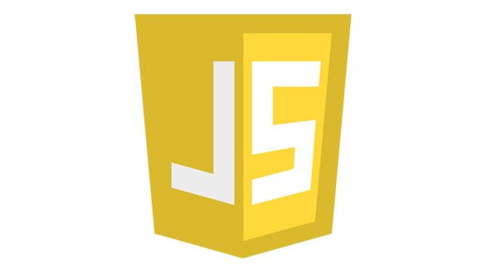

Slide 3
What is JavaScript

Slide 4
Introduction to JavaScript
JavaScript is a scripting language.
Programming language that is executed without being compiled
It is a CASE SENSITIVE language
A scripting language is not compiled – it is interpreted line by line.
A Web browser that contains a scripting engine is called a scripting host.
Is not Java. Only borrows syntax style from Java.

Slide 5
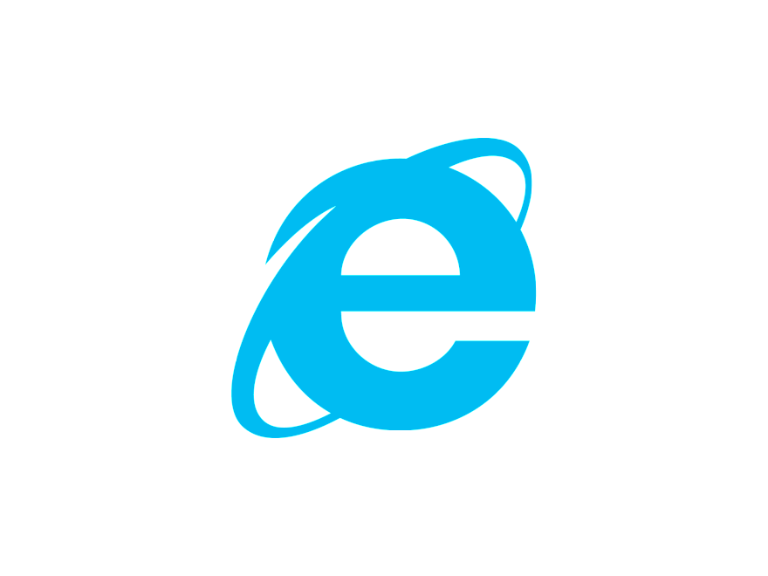
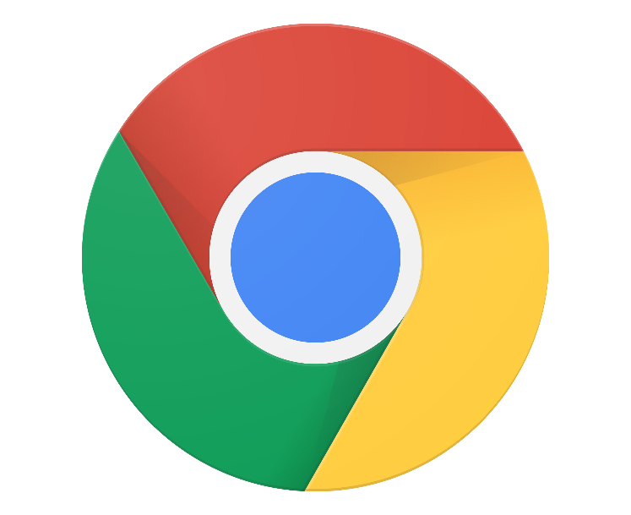


Slide 6
Introduction to JavaScript
JavaScript was created by Brendan Eich at Netscape during the “browser wars”
As the web grew in popularity, the need for increased user experience and interactivity with web sites was desired

Slide 7
JavaScript is a programming language that allows you to implement complex, dynamic features on web pages

Slide 8
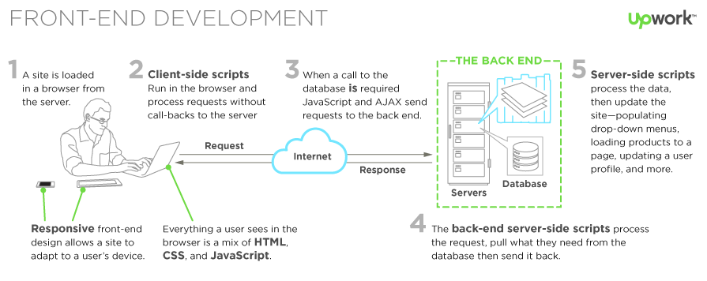
How Client-Server Architecture Works

Slide 9
Client-Side Scripting
Website Interacting Components
Web Server
Hosts
Static html files and assets (example: images, sound, video)
CSS files
JavaScript files
Server side code for generating dynamic html
Receives requests from clients
Access data from a database
Sends a response back to the client
Database Server
Stores or persists data between requests and visits
Client
A user accessing website web pages (accessing html, css, js) using a browser on a laptop, desktop, mobile device
Receives html, CSS and JavaScript that is executed within the browser

Slide 10
Introduction to JavaScript
In Fundamentals of Web we learned how to control the structure, look and feel of a web page with HTML and CSS
We will now focus on the behavior of our web pages with JavaScript

Slide 12
JavaScript syntax and conventions
JavaScript is loosely typed
We do not define a data type for a variable
Strongly typed languages include:
C#
C++
Java
TypeScript
…

Slide 13
JavaScript syntax and conventions
Loosely typed languages include
JavaScript
PHP
Perl

Slide 14
JavaScript syntax and conventions
JavaScript like C# is case sensitive
Examples
//C#
int grade = 93; string Grade = “A”;
//JavaScript let grade = 97;
let Grade = “A”;

Slide 15
JavaScript syntax and conventions
JavaScript lines are terminated with a semi-colon
Now optional but needed for single line multiple expressions
Examples
let x = 7; //this is ok
let y = 8 //this is ok let a, b, c, d; let e = “Chris” //Ok. multiple expressions on one line
let f,g,h let i=0 //Not ok. Syntax error

Slide 16
JavaScript syntax and conventions
Tab Formatting
Our style guide
Tabs not Spaces!
Examples
let iHeartJavaScript = true;
if(iHeartJavaScript){
console.log('You are awesome.');
} else {
console.log('You are awesome but not loving JavaScript makes you slightly less so.');
}
Tab formatting for readability
Tab formatting for readability

Slide 17
JavaScript syntax and conventions
Authoring Comments
Examples /**
* Author: Chris Cusack
* Title: Exercise 1 - Variables
* Date: 01/07/2020
*/
console.log(‘Hello World’);

Slide 18
JavaScript syntax and conventions
Conventions
Camel Case
Variables and method names are camel case
Classes Pascal case
Variables, Functions and Class names
Meaningful names given

Slide 19
JavaScript syntax and conventions
Conventions
Examples //Proper convention case and variable name is meaningful let firstName = ‘Chris’; //Meaningful name but pascal case is for class names by let LastName = ‘Cusack’; //Proper case but not meaningful let xyz = ‘Super important variable’; /* Meaningful variable names allows our code to be self documenting. There should be no confusion as to the use of a variable. */

